Slide 1

Campus Eats Narrated PPT
ITCS 6160
Yike Li

Slide 2
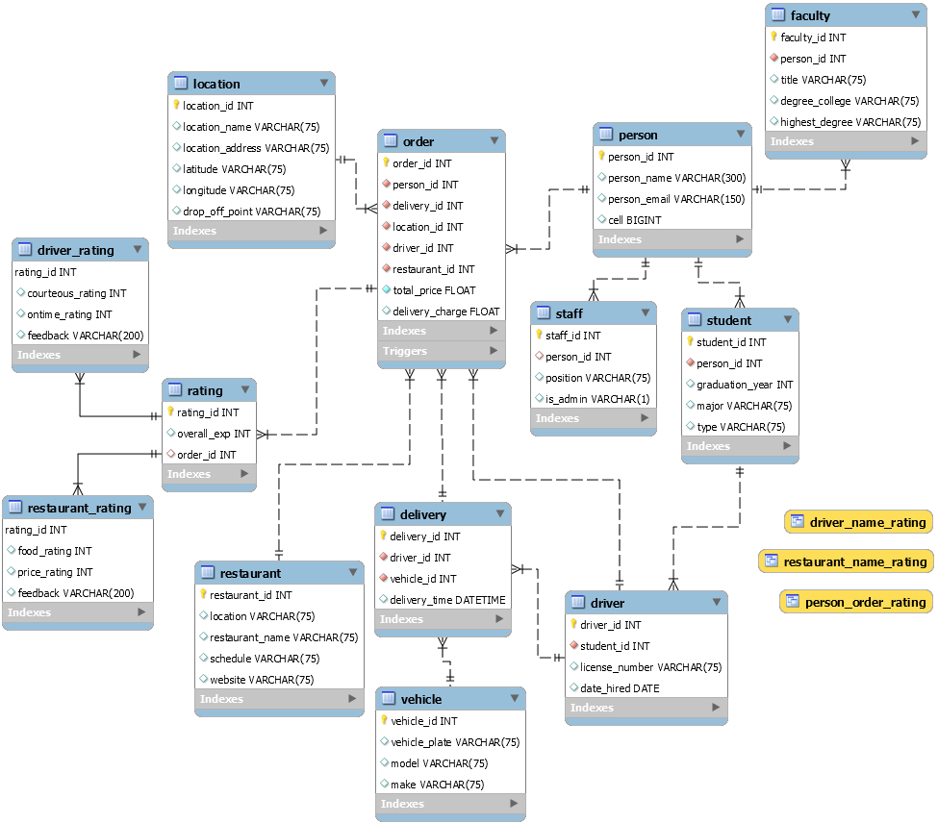

Model
Notes:
This is the EER diagram of my model. I add 3 tables based on the existing tables: rating, driver_rating, and restaurant_rating.
Rating table as the supertype table. Underneath it are the two subtype tables: driver_rating and restaurant_rating.

Slide 3
CREATE TABLE Code for new tables
CREATE TABLE `campus_eats_fall2020`.`rating` (
`rating_id` INT(11) NOT NULL AUTO_INCREMENT,
`overall_exp` INT(11) NULL,
`order_id` INT(11) NULL,
PRIMARY KEY (`rating_id`),
KEY `fk_order_rating` (`order_id`),
CONSTRAINT `fk_order_rating` FOREIGN KEY (`order_id`) REFERENCES `campus_eats_fall2020`.`order` (`order_id`))
CREATE TABLE `campus_eats_fall2020`.`driver_rating` (
`rating_id` INT(11) NOT NULL,
`courteous_rating` INT(11) NULL,
`ontime_rating` INT(11) NULL,
`feedback` VARCHAR(200) NULL,
PRIMARY KEY (`rating_id`),
KEY `fk_driver_rating` (`rating_id`),
CONSTRAINT `fk_driver_rating` FOREIGN KEY (`rating_id`) REFERENCES `campus_eats_fall2020`.`rating` (`rating_id`))
CREATE TABLE `campus_eats_fall2020`.`restaurant_rating` (
`rating_id` INT(11) NOT NULL,
`food_rating` INT(11) NULL,
`price_rating` INT(11) NULL,
`feedback` VARCHAR(200) NULL,
PRIMARY KEY (`rating_id`),
KEY `fk_restaurant_rating` (`rating_id`),
CONSTRAINT `fk_restaurant_rating` FOREIGN KEY (`rating_id`) REFERENCES `campus_eats_fall2020`.`rating` (`rating_id`))

Slide 4
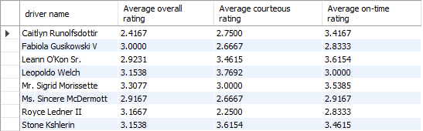
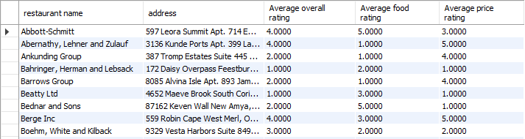
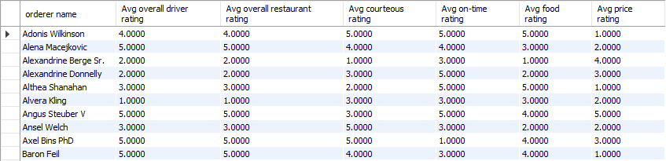
Views with Output
View 1:
driver_name_rating
View 2:
restaurant_name_rating
View 3:
person_order_rating

Slide 5
Indexes
Covering index (restaurant_id, restaurant_name)
CREATE INDEX restaurant_restaurant_id_restaurant_name_ix
on restaurant (restaurant_id, restaurant_name);
Covering index (restaurant_id, location)
CREATE INDEX restaurant_restaurant_id_location_ix
on restaurant (restaurant_id, location);
Covering index (location_id, location_address)
CREATE INDEX location_location_id_location_address_ix
on location (location_id, location_address);

Slide 6
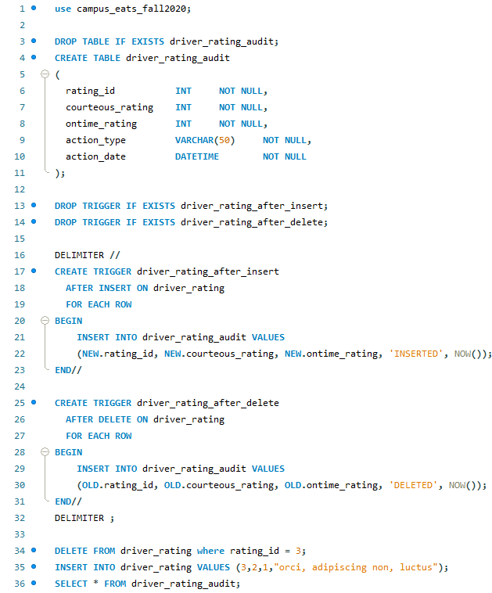
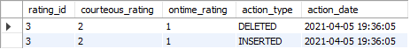
Triggers
A DELETE statement causes the second trigger to fire. Then an INSERT statement causes the first trigger to fire. The evidence of successful completion is as follows:

Slide 7
Stored Procedures
CREATE DEFINER=`root`@`localhost` PROCEDURE `add_person`(in person_name varchar(300), in email varchar(150), cellno bigint (15), person_type varchar(10))
BEGIN
insert into person (person_name, person_email, cell) values(person_name, email, cellno);
if(person_type = 'student') then
insert into student (person_id, graduation_year, major, type) values ((select person_id from person where cell = cellno), 2019, 'Computer Science', 'Graduate’);
elseif(person_type = 'faculty') then
insert into faculty (person_id, title, degree_college, highest_degree) values ((select person_id from person where cell = cellno), 'Assistant Professor', 'UCLA', 'PhD’);
elseif(person_type = 'staff') then
insert into student (person_id, position, is_admin) values ((select person_id from person where cell = cellno), 'Bus Driver', 'N’);
end if;
END

Slide 8
Corrections to Existing Database
Removed the “rating” column from the driver table

